Slide 1
Out of the blue comes green.

Slide 2


Slide 3
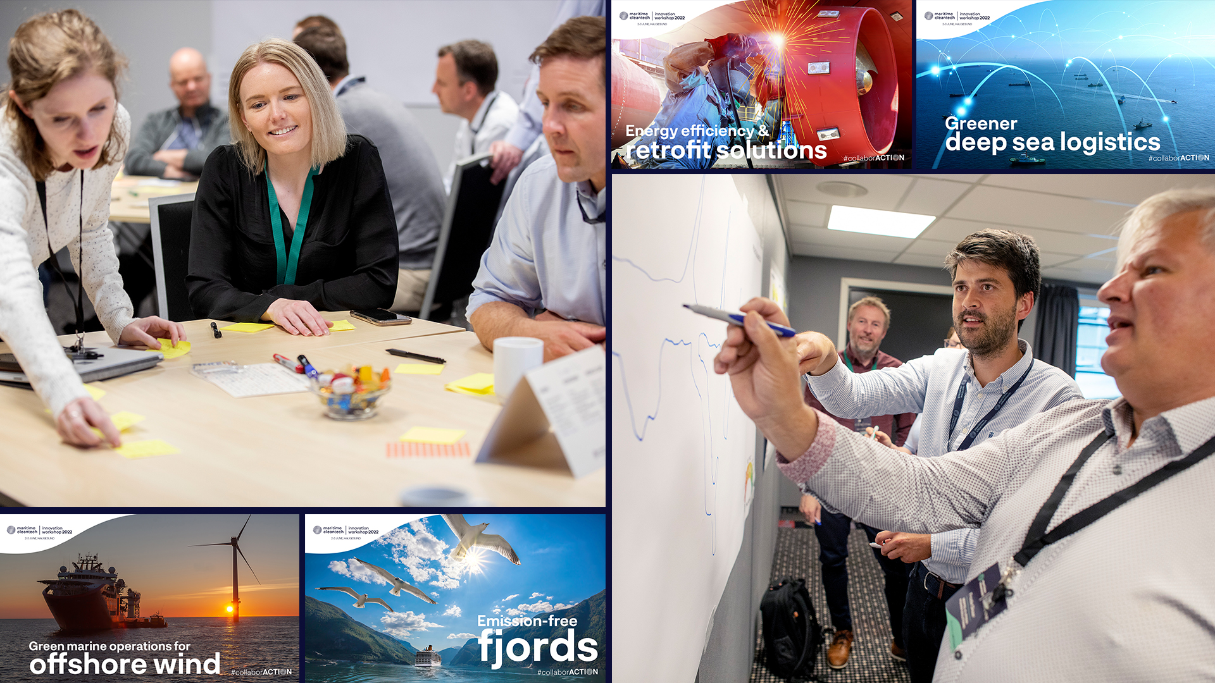

Slide 4
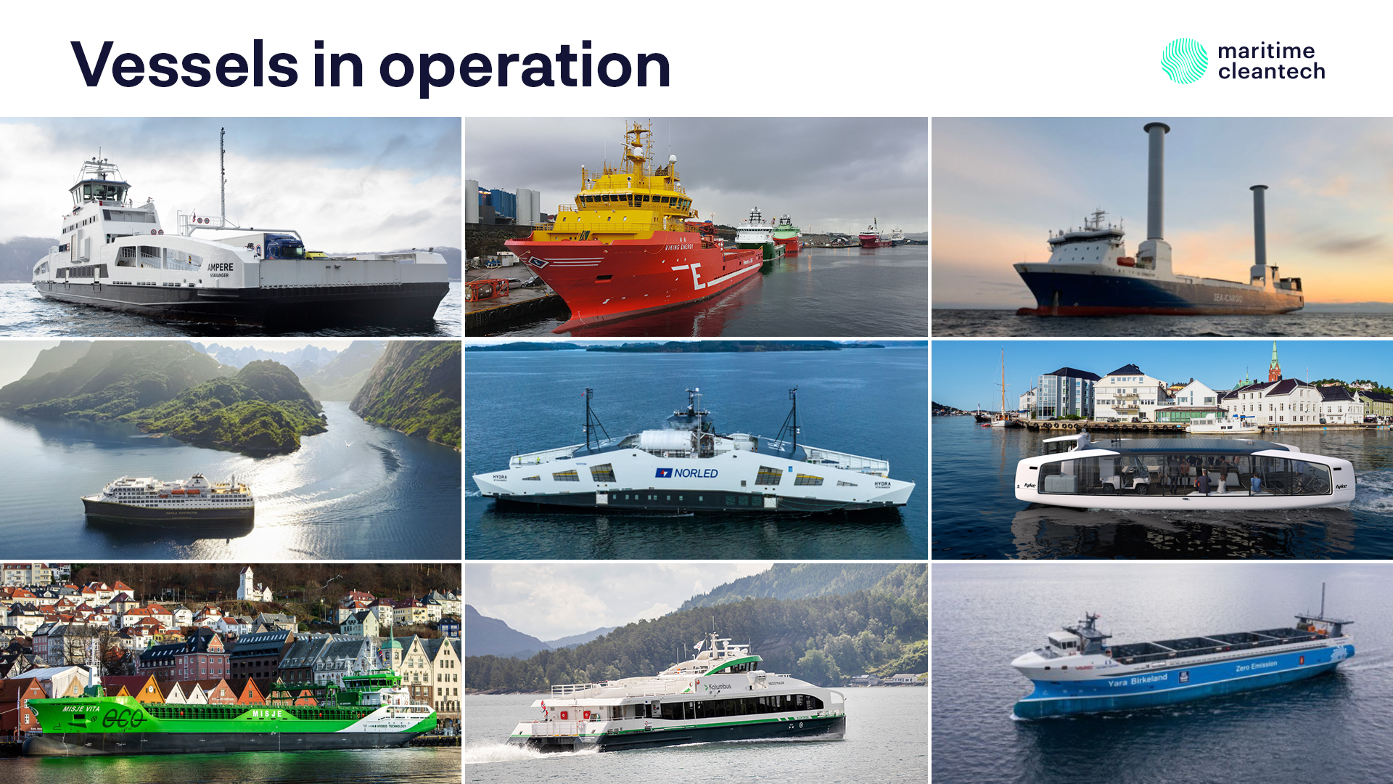

Slide 5
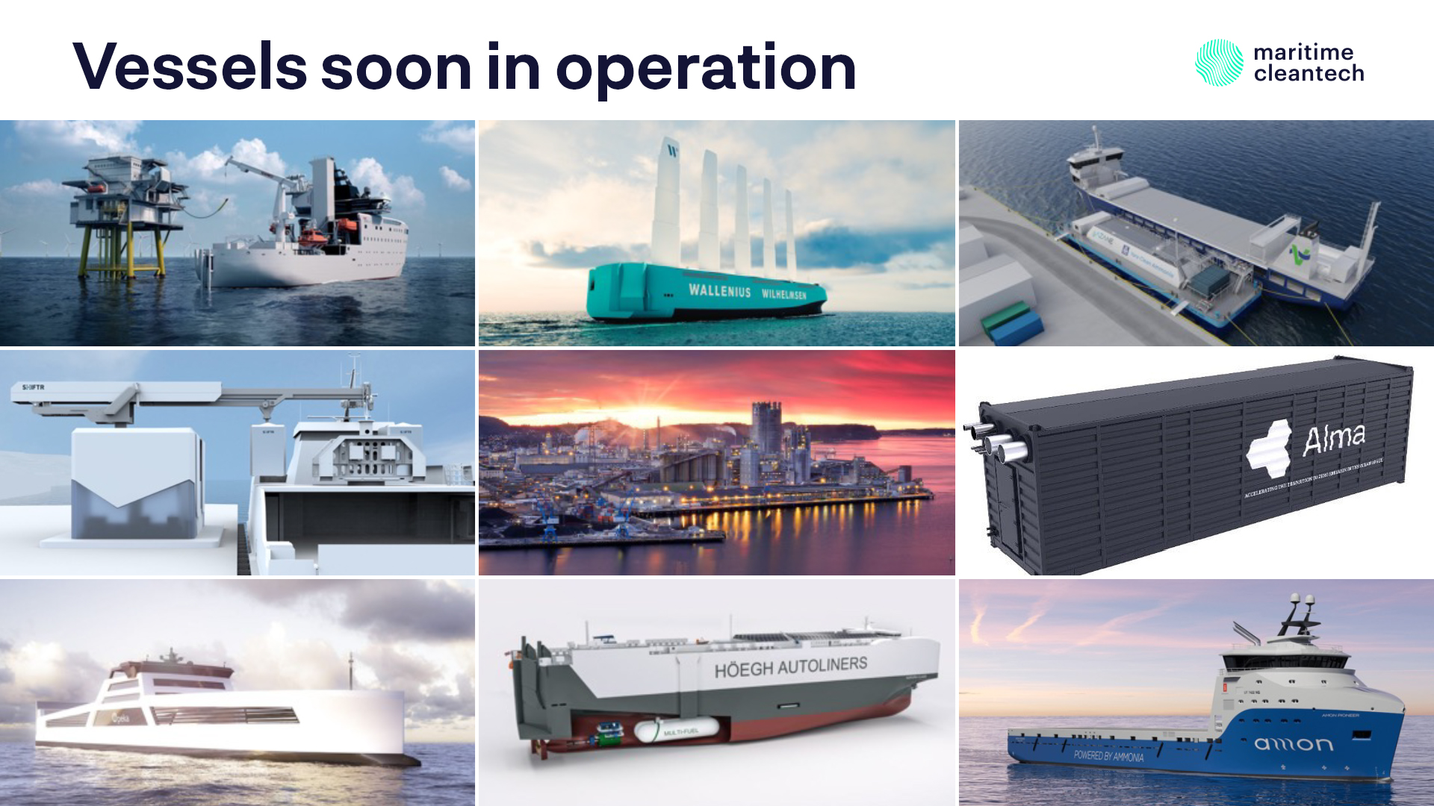

Slide 6
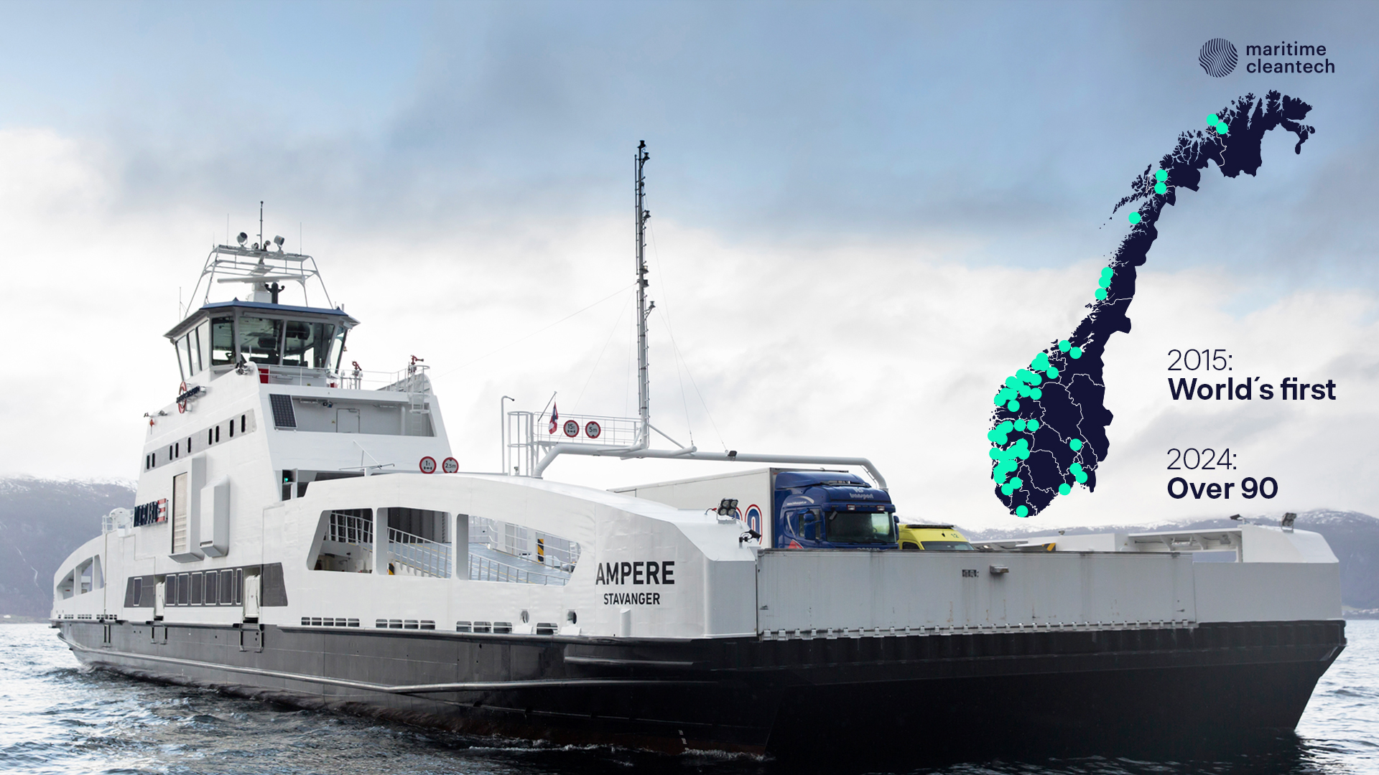

Slide 7
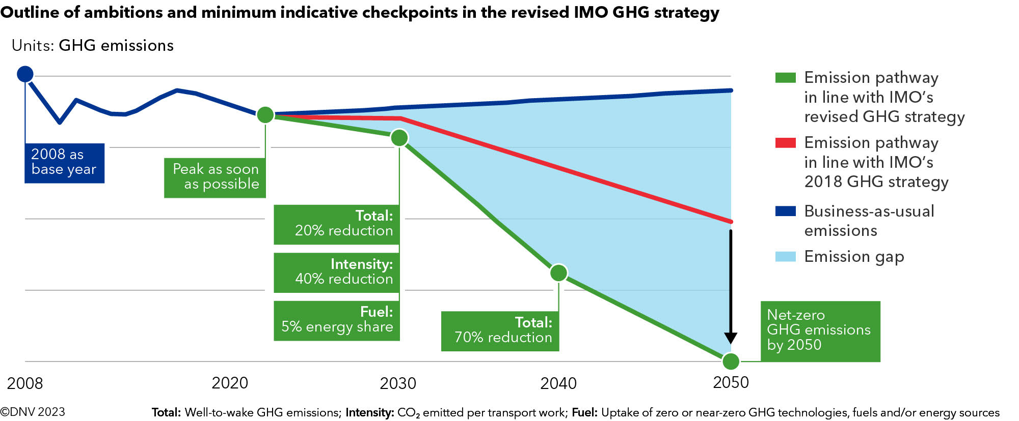
Towards 2030 and 2050: ACTION needed

Slide 8
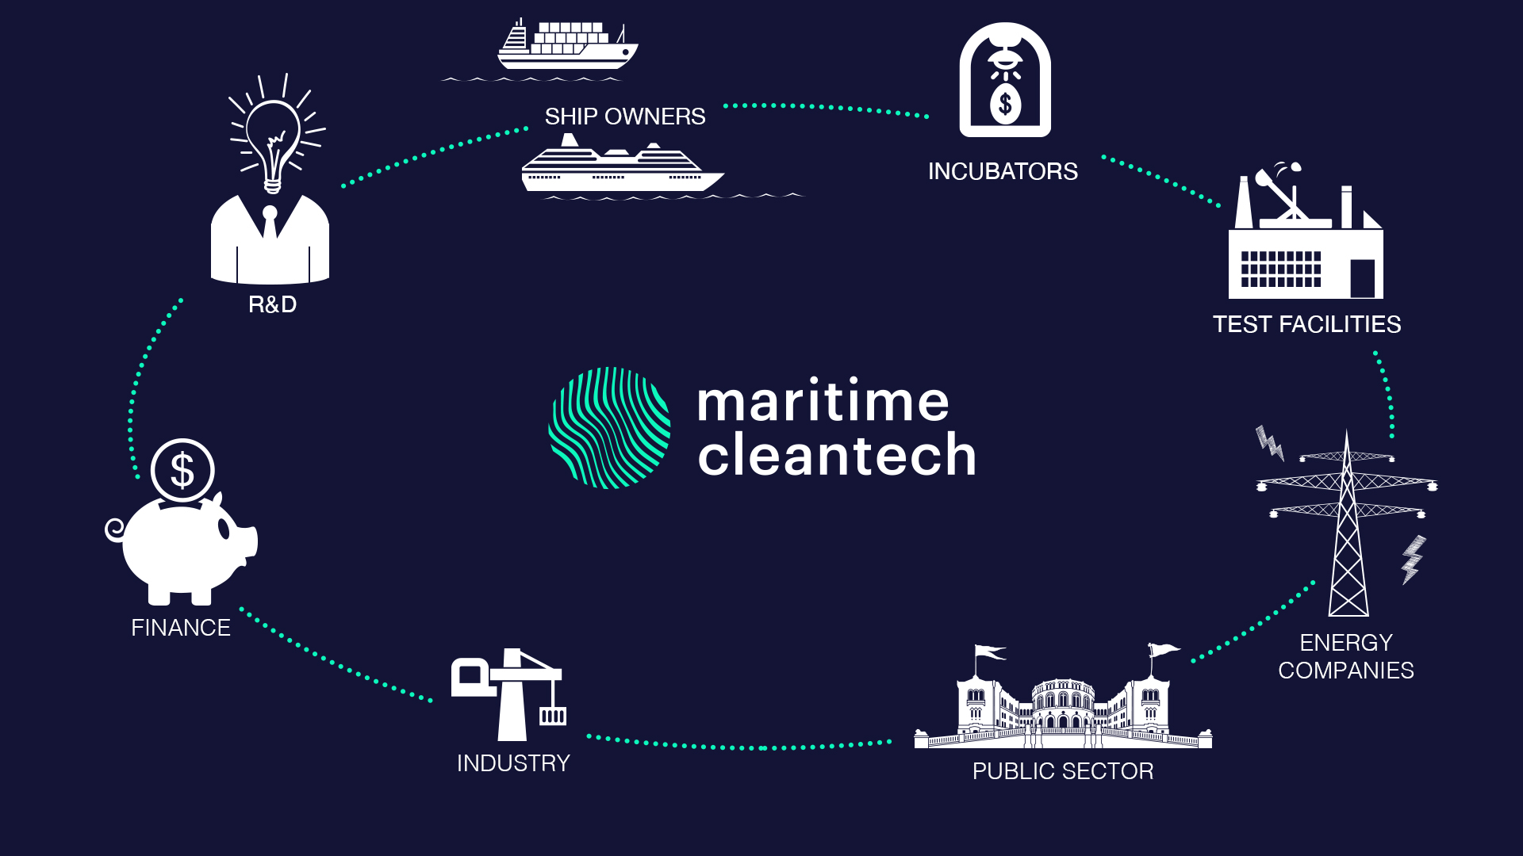
Partnership covering the entire maritime value chain

Slide 9
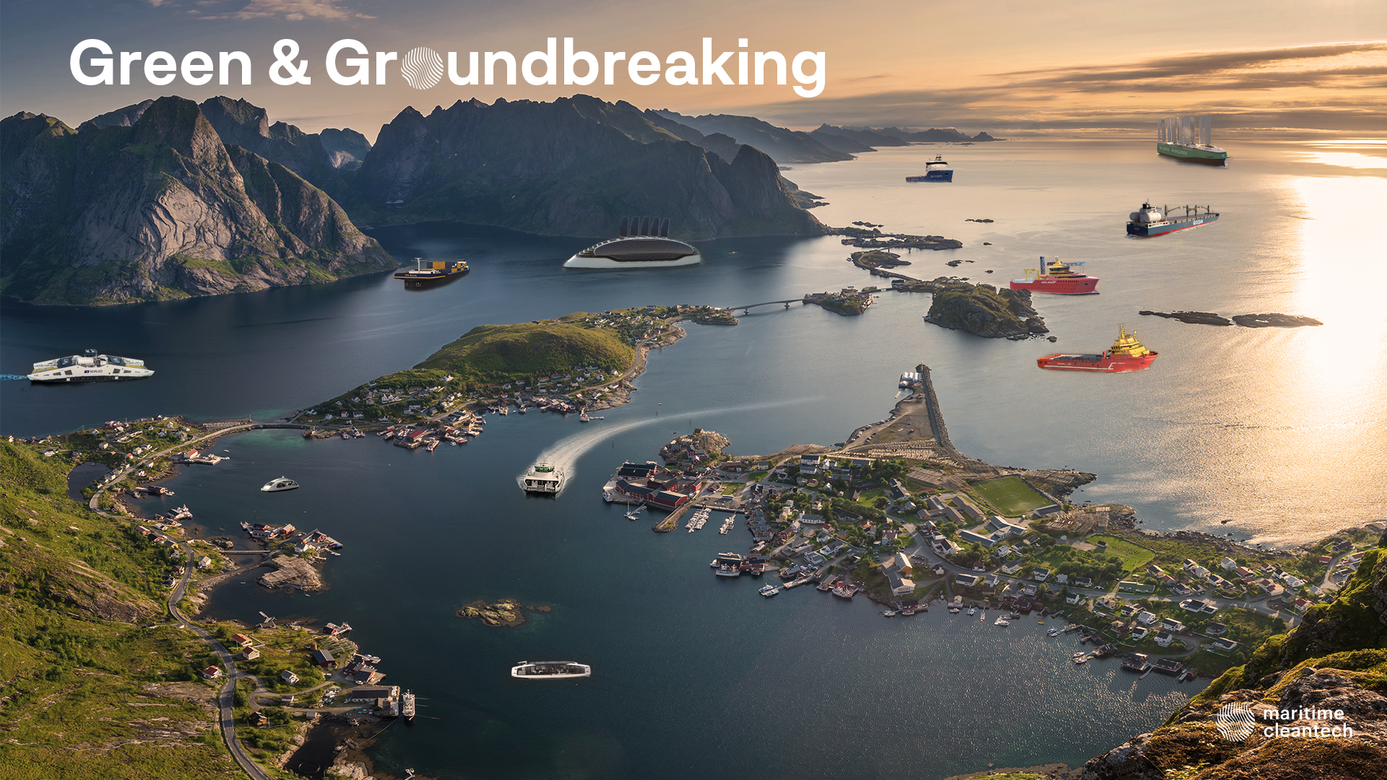

Notes:
Work with all relevant segments. They are at different stages in the green tranistion.
We see important synergies in using «early wins» in «easy to abate» sectors to gradually providing better solutions also to e.g. deep sea
Technologies
Testing and piloting
Mind-set
Training
Safety
Legislation
policies
Public acceptance

